Slide 1

Portable Arm CMM
By-
1. Aniket Mandawar-26
2. Parth Pandhre -33

Slide 2
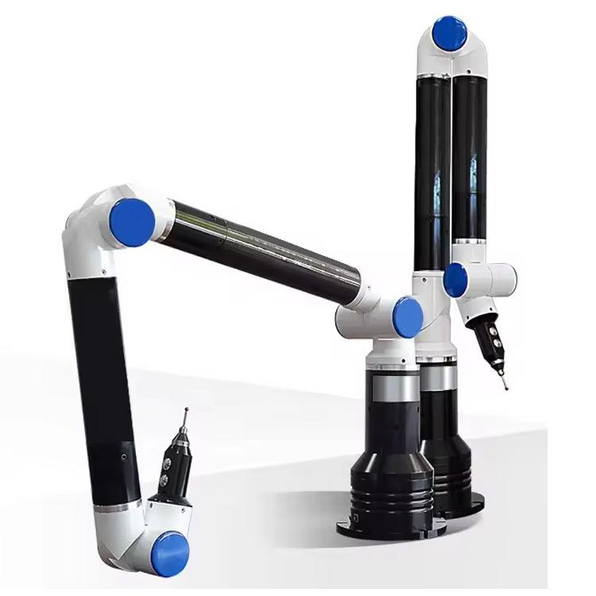
Introduction
Portable Arm CMM is a 3D measurement device.
Used for inspection, quality control, reverse engineering .
Can measure directly on shop floor .
Eliminates need to move heavy components .

Slide 3
Problem Statement :
In industries, large and heavy components are difficult to move to traditional CMM.
Traditional CMM is fixed, costly, and time-consuming.
Need for on-site measurement in workshops and production lines .
Requirement of quick inspection with reasonable accuracy.

Slide 4
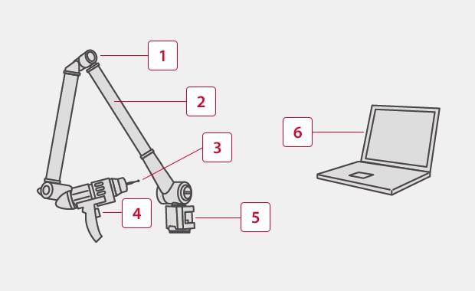
Construction / Components:
Base: Rigid support, fixed on table .
Articulated Arm: Lightweight, high mobility.
Encoders: Optical/rotary → angle measurement .
Probe/Stylus: Contact or laser scanning.
Controller & Software: Data processing and analysis.

Slide 5
Working Principle:
Works on Coordinate Geometry + kinematics.
Arm has 6–7 rotary joints (degrees of freedom) .
Each joint contains high-precision encoders .
Step-by-step working:
Operator moves the arm manually .
Encoders measure angular position of each joint .
System applies forward kinematics to calculate position.
Probe touches surface → exact X, Y, Z coordinates recorded.
Multiple points collected → 3D model created.
Software compares data with CAD model → detects errors

Slide 6
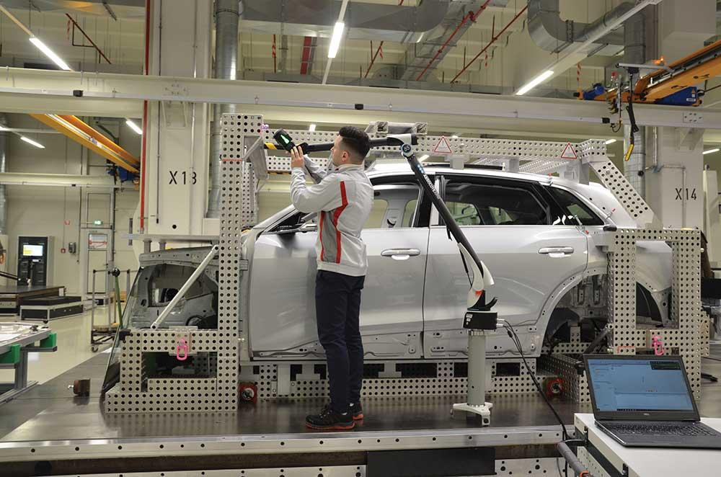
Types + Applications:
Types:
Touch probe
Laser scanner.
Applications:
Automobile industry
Aerospace
Reverse engineering
Tool & die inspection

Slide 7
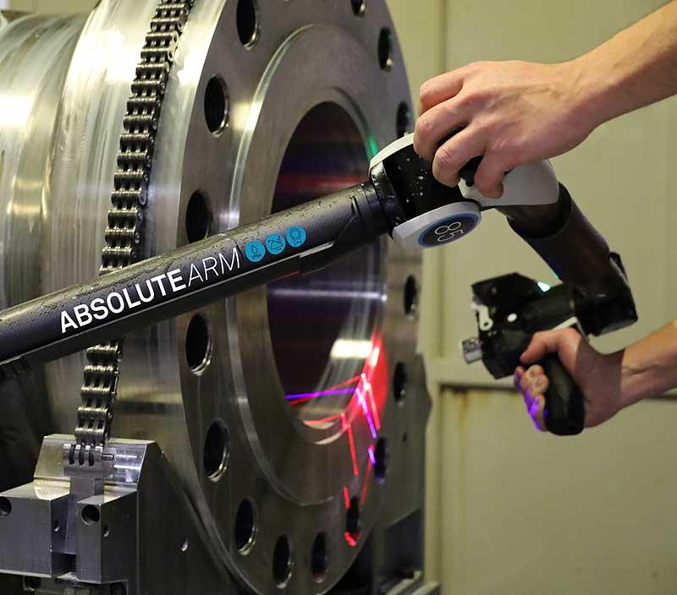
Advantages & Limitations:
Advantages:
High portability and flexibility .
Quick setup, saves time.
3. Can measure large & complex shapes .
4. Suitable for field inspection .
Limitations:
Accuracy lower than traditional CMM (~±0.02 to 0.05 mm)
Operator dependent .
2. Affected by temperature & vibration .
3. Limited working volume

Slide 8
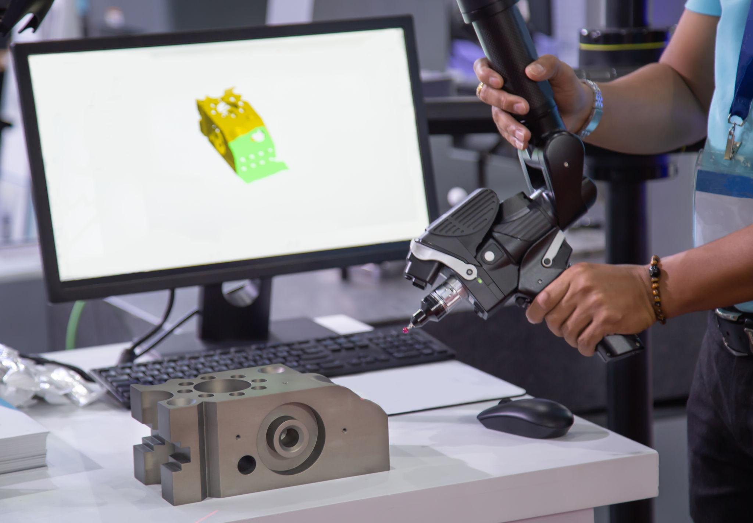
Conclusion
Portable Arm CMM is a modern, flexible measuring tool
Ideal for on-site inspection and large parts .
Plays an important role in advanced manufacturing and quality control

